Slide 1

Walmart Stores Sales Analysis 2010 - 2012
Presented by: Ahmed Lawal

Slide 2
Historical Background
Walmart was founded in 1962 by Sam Walton with a simple but powerful vision: make everyday products affordable for ordinary people.
From a single discount store in Rogers, Walmart grew into the world’s largest retailer by mastering low-cost operations, supply chain efficiency, and customer-focused pricing.
Beyond retail dominance, the company has become a global, data-driven enterprise that uses technology and analytics to forecast demand, manage inventory, and enhance customer experience in an increasingly competitive market.

Slide 3
Project Overview
This project looks at Walmart’s historical weekly sales data to understand how the business has performed, spot key trends, and improve future sales forecasting.
It focuses on a common retail challenge: making sure products are available when customers need them, without overstocking or wasting resources. When demand is misjudged, it can lead to empty shelves, excess inventory, lost sales, and unhappy customers.
The analysis explores how factors like holidays, fuel prices, unemployment, and the consumer price index affect sales across different stores and departments. The goal is to generate useful insights that support better planning and decision-making and ultimately help build a more accurate system for predicting future demand.

Slide 4
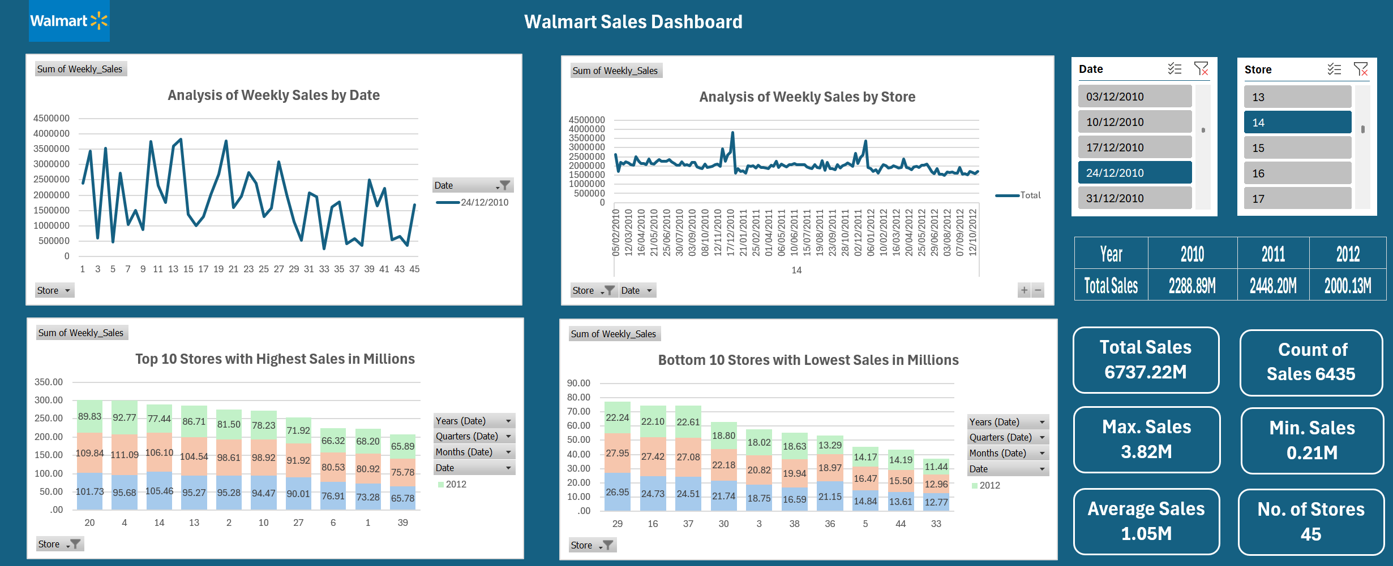

Slide 5
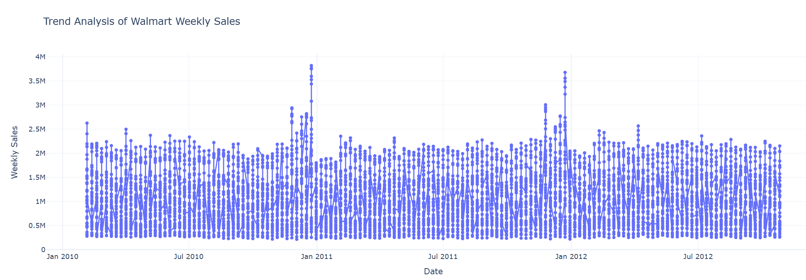

Slide 6
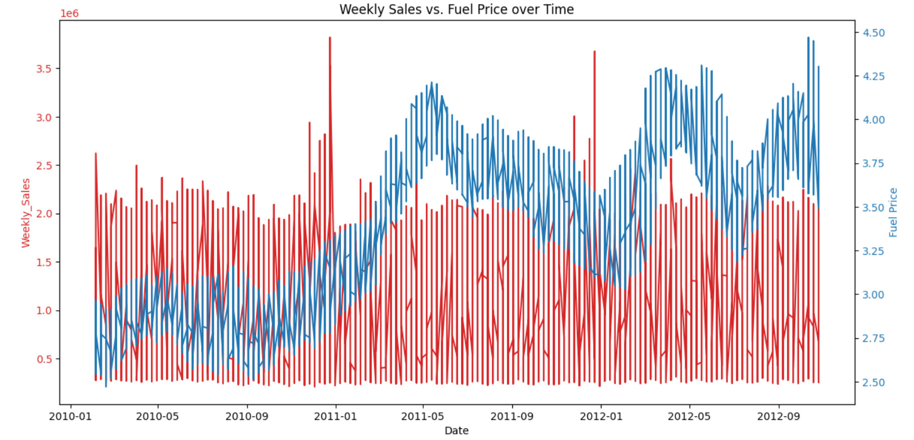

Slide 7
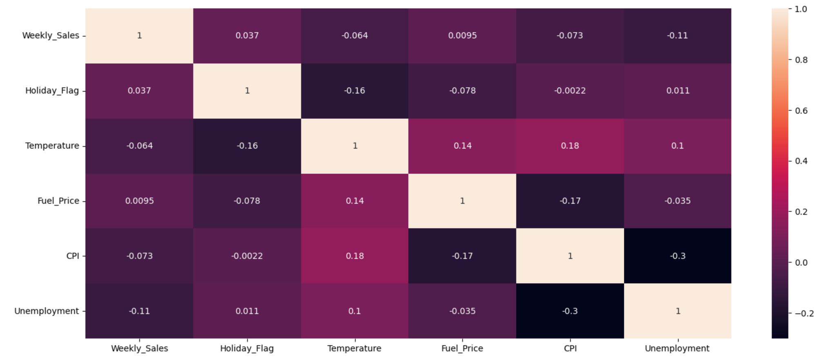
Correlation of Weekly Sales to other Environmental Factors

Slide 8
Walmart Sales Overview (2010–2012)
Walmart Sales Overview (2010–2012)
Key Insights
Total Sales reached $6.74B across 45 stores and 6,435 sales records.
2011 delivered the strongest performance with $2.45B, outperforming 2010 and 2012.
Average sales per record stood at $1.05M, showing strong weekly revenue consistency.
Peak sales hit $3.82M, indicating strong seasonal / promotional demand spikes.
Store 20, 4, 14, 13 and 2 are the top revenue-generating stores.
Lowest performing stores include 33, 44, 5, 36 and 29, requiring turnaround focus.
Weekly sales trend shows high volatility, suggesting strong seasonality and promotion dependency.

Slide 9
Recommendations
Revenue Growth
Replicate best practices from Top 5 stores into mid-performing stores.
Increase investment, assortment, and staffing in high-performing stores.
Underperforming Stores
Conduct root-cause review on bottom stores:
Foot traffic
Pricing
Product mix
Local competition
Seasonal Planning
Prepare inventory and workforce ahead of peak demand periods.
Improve promotion calendar based on high-sales weeks.
Plan cashflow around predictable low months - Jan/Nov dips
Shift from reactive reporting → proactive demand planning

